Slide 1




Ad-hoc Insights
Consumer Goods
Presented By
Bhushan Gaidhane

Slide 2
Objective’s
Agenda
Company overview
Company market’s
Data
Request’s & Tools
Insight’s

Slide 3
Objective’s
AtliQ Hardware (imaginary company) is one of the major computer hardware manufacturers in India, with a strong presence in the nations.
The management noticed that they do not get enough insights to make quick and smart data-informed decisions.
The Management team Plan's to expand the data analytics team by adding junior data analysts.
To assess both technical and soft skills, Data Analytics Director, Tony Sharma, planned to conduct an SQL challenge for potential hires (Junior Data Analysts).
The company aims to gain insights from the expanded team to address 10 ad-hoc requests.

Slide 4
Company overview
Atliq Hardware is a computer hardware and accessory manufacturer.
PC
P&A
N&S
Division
Desktop
Notebook
Peripherals
Accessories
Networking
Storage
Segment
Business Laptop
Gaming Laptop
Graphic
Card
Batteries
External
SSD
WiFi Extender
Internal HDD
Category
Personal Laptop
Business Laptop
Keyboard
USB Flash Drive
MotherBoard
Personal Laptop
Mouse
Processors

Slide 5

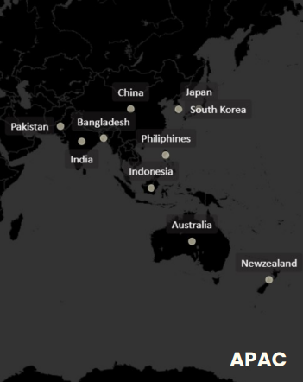
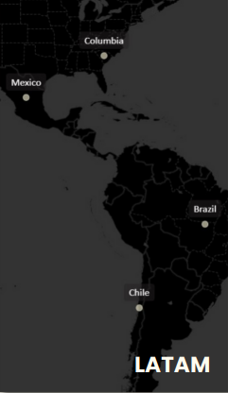
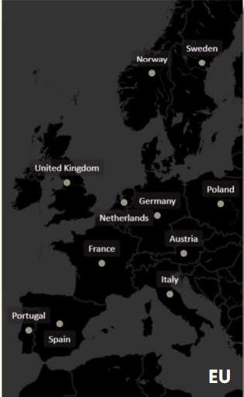
Company Market’s
Per Region Wise
2
9
4
11

Slide 6
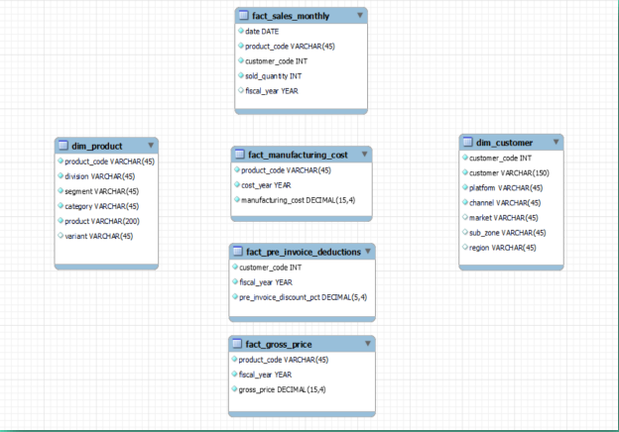
data
Dim_Customer
Dim_product
Fact_sales_monthly
Fact_manufacturing_cost
Fact_pre_invoice_deduction
Fact_gross_price

Slide 7
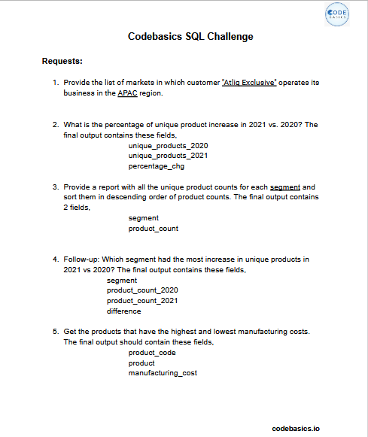

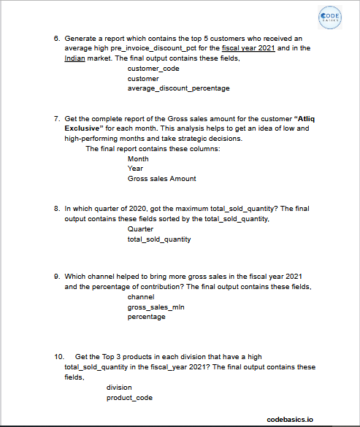

Request’s & Tools

Slide 8

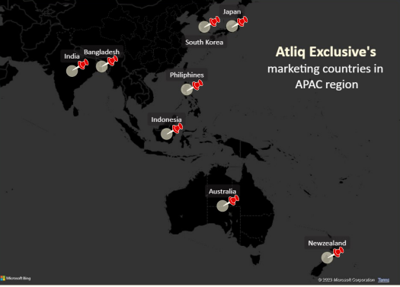
Insight’s
Request 1.
Provide the list of markets in which customer "AtliQ Exclusive " operates its business in the APAC region.
Insight’s
In the APAC region, AtliQ Exclusive store has established its presence in 8 major markets.

Slide 9

Request 2.
What is the percentage of unique product increase in 2021 vs. 2020? The final output contains these fields,
unique_products_2020, unique_products_2021, percentage_chg
Percentage
Change 36.33%
Insight’s
It’s a good sign that we are continuously innovating and introducing new products to the market. In FY 2020, we had a total of 245 products, but in FY 2021, our count increased by 36% to 334 products.
Means Demand and production both increased

Slide 10
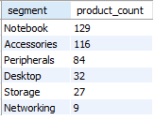
Request 3.
Provide a report with all the unique product counts for each segment and sort them in descending order of product counts. The final output contains 2 fields,
Segment, product_count .
Unique Products Counts for each Segment
Alarming
Insight’s
Segments: notebooks, accessories, and peripherals are showing significant manufacturing growth as compared to desktops, storage, and networking.
Notebooks, accessories, and peripherals constitute 83% of the total manufactured product.
Suggestions
-> Package Deal -> Customer Services -> Free Vouchers ->Student Discount -> Cash Back -> Gift cards -> Memberships

Slide 11
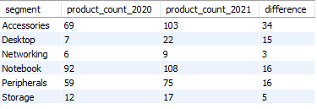
Request 4.
Follow-up: Which segment had the most increase in unique products in 2021 vs 2020? The final output contains these fields,
Segment, product_count_2020, product_count_2021, difference
Unique Product Difference Per
Segment From 2020 to 2021
Insight’s
Accessories had the largest increase in production.
Storage and Networking are experiencing slower production growth than other segments.
2020
2021

Slide 12

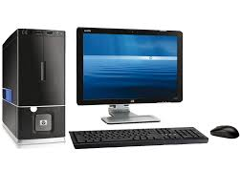

Request 5.
Get the products that have the highest and lowest manufacturing costs. The final output should contain these fields,
product_code, product, manufacturing_cost
$263.4
A6121110208
AQ HOME Allin 1 Gen 2
Personal desktop
$0.86
A2118150101
AQ Master wired x1 Ms
Mouse
Insight’s
Mouse: AQ Master wired x1 Ms (Variant:Standard1) has the lowest manufacturing cost.
Personal Desktop: AQ Home Allin1 Gen2 (Variant:Plus3) has the highest manufacturing cost.

Slide 13
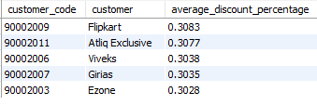
Request 6.
Generate a report which contains the top 5 customers who received an average high pre_invoice_discount_pct for the fiscal year 2021 and in the Indian market. The final output contains these fields,
customer_code, customer, average, discount_percentage
Top 5 Indian customers with highest
average discount percentage for FY 2021
Insight’s
The largest average pre-invoice discount was given to Flipkart.
The least average pre-invoice discount was given to Amazon.

Slide 14
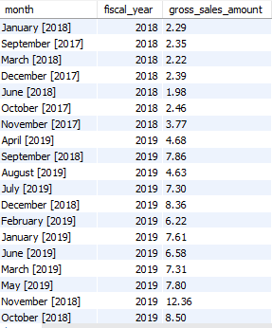
Request 7.
Get the complete report of the Gross sales amount for the customer “Atliq Exclusive” for each month. This analysis helps to get an idea of low and high-performing months and take strategic decisions. The final report contains these columns:
Month, Year, Gross sales Amount
FY 2018
26.8 M
FY 2019
89.1 M
FY 2018 & 2019

Slide 15
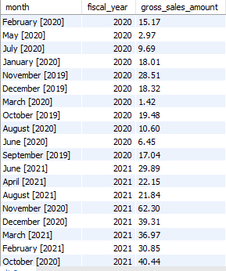
FY 2020
79.5 M
FY 2021
224.4 M
FY 2020 & 2021
Insight’s
The lowest Gross sales total for both fiscal years is in March(2020).
The highest Gross sales total for both fiscal years is in November (2020).
73.8% of the total Gross sales figure is in FY2021.
Reasons : COVID-19, Global Chip shortage

Slide 16

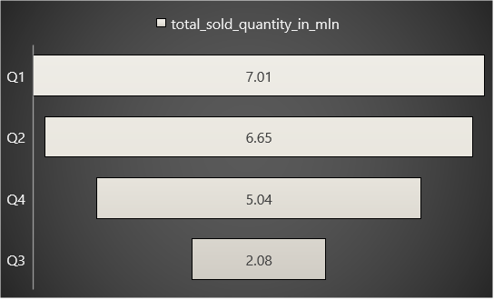
Request 8.
In which quarter of 2020, got the maximum total_sold_quantity? The final output contains these fields sorted by the total_sold_quantity,
Quarter , total_sold_quantity
Sold Quantity in FY 2020 as per quarters
Insight’s
Quarter 1 of FY2020 saw the most units sold overall, while Quarter 3 had the fewest.
The highest and lowest overall sold quantity is in December and March.
Quarter1 accounts for approximately 34% of the total sold quantity for FY2020.

Slide 17

Request 9.
Which channel helped to bring more gross sales in the fiscal year 2021 and the percentage of contribution? The final output contains these fields,
Channel, gross_sales_mln, percentage
Gross Sales and Contribution Percentages by
Channels for FY 2021
Insight’s
Channel: "Retailer " helped bring maximum sales to the company with 73.22% as the contribution percentage.
Channel: "Distributor " makes the least contribution at a percentage of 11.31%.

Slide 18
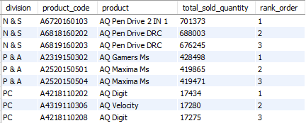
Request 10.
Get the Top 3 products in each division that have a high total_sold_quantity in the fiscal_year 2021? The final output contains these fields,
Division, product_code, product, total_sold_quantity, rank_order
Insight’s
Every division has a product with different variants that appears twice in the top three products by division list.

Slide 19

Thank you
Bhushan Gaidhane
bgaidhane815@gmail.com

